Slide 1
Capstone Project by Group 11 (The BLOSSOM TEAM
Final Project Presentation
By:
Faith Taremwa, Nnyenje Ibrahim, Walter Mutegyeki, Amanda Kyokusiima, Walter Odongo
Certificate in Artificial Intelligence and Machine learning
Refactory Academy

Slide 2

Loan Default Prediction Challenge
A Machine Learning based solution.

Slide 3
1. INTRODUCTION
1. Introduction
2. Objectives, Aims and development Goals
3. Problem statement and Project Significance
4. Analysis questions
5. Methodology

Slide 4
Introduction
Context of Digital Lending in Sub-Saharan Africa:
The digital lending landscape in Sub-Saharan Africa has experienced exponential growth, driven by technological innovations and widespread mobile phone usage.
Platforms like SuperLender are leading the way in providing financial services to underserved populations, bridging the gap between traditional banking and the unbanked.
2. Importance of Accurate Loan Risk Assessment:
Accurate loan risk assessments are crucial to the sustainability of digital lending platforms.
Inaccurate predictions can lead to significant financial losses, affecting both lenders and borrowers.
Traditional credit scoring methods often fall short in the dynamic and data-rich environment of digital lending.
Loan Default Prediction

Slide 5
Objective and Aims
To develop a supervised machine learning-based lending risk assessment model that enhances the accuracy and reliability of loan default predictions.
By leveraging advanced machine learning techniques, the model aims to minimize financial risks and maximize financial inclusion opportunities in Sub-Saharan Africa.
Create four predictive models: Random Forest, Logistic Regression, ANN.
Evaluate performance and optimize the best model.
Development Goals

Slide 6
Problem Statement
Challenges in Loan Risk Assessment:
Inaccurate predictions can lead to financial losses.
Traditional methods are limited.
Need for Advanced Approaches:
Machine learning algorithms can provide better accuracy.

Slide 7
Significance of the Project
1. Impact on Financial Institutions:
Improved credit risk assessment.
Enhanced profitability.
2. Benefits for Borrowers:
Increased access to credit.
Fairer loan terms.

Slide 8
Analysis questions
What are the most important features that contribute to the loan default model, and how can we improve their accuracy?
How do the performance metrics, such as accuracy, precision, recall, and F1 score, differ between the different machine learning algorithms?
How does the size of the dataset impact the performance of the different machine learning algorithms?
Which machine learning algorithm performed the best overall in detecting loan defaults?
What are the potential implications of implementing the most effective machine learning algorithm for loan defaults in the lending industry?

Slide 9
Methodology
The project methodology involved:
1. Data Collection:
19281 samples including demographic, performance and previous loan data.
2. Data Preprocessing:
Handling missing values and outliers.
Label Encoding
Data imbalance
Feature selection and rank correlation tests.
3. Model Implementation:
SVM, Random Forest, Logistic Regression, ANN

Slide 10
4. Dataset Description
A multivariate loan default labeled raw dataset sourced from https://zindi.africa/competitions/data-science-nigeria-challenge-1-loan-default-prediction comprising of 28 features for superlender digital lending company
In Summary:
Data Set Characteristics: Multivariate Dataset
Number of Instances: 19281
Area: Lending
Attribute Characteristics: Categorical and Numeric
Number of Attributes: 28
Date Accessed: 10-04-2024
Missing Values? Yes
Associated Tasks: Analysis, Classification, and Prediction

Slide 11
2. MAIN BODY
1. Data preparation
2. Univariate and multivariate analysis
3. Analysis of Results: Summary of observations

Slide 12
1. Dataset Preparation
The following data preparation steps and actions were undertaken to generate an accurate, and representative data:
Analysis of each univariable was conducted to identify any existing gaps that could compromise the final conclusions.
The following were identified and removed/aligned:
Missing values
Datatype mismatch
Unnecessary columns
Unclear character types

Slide 13
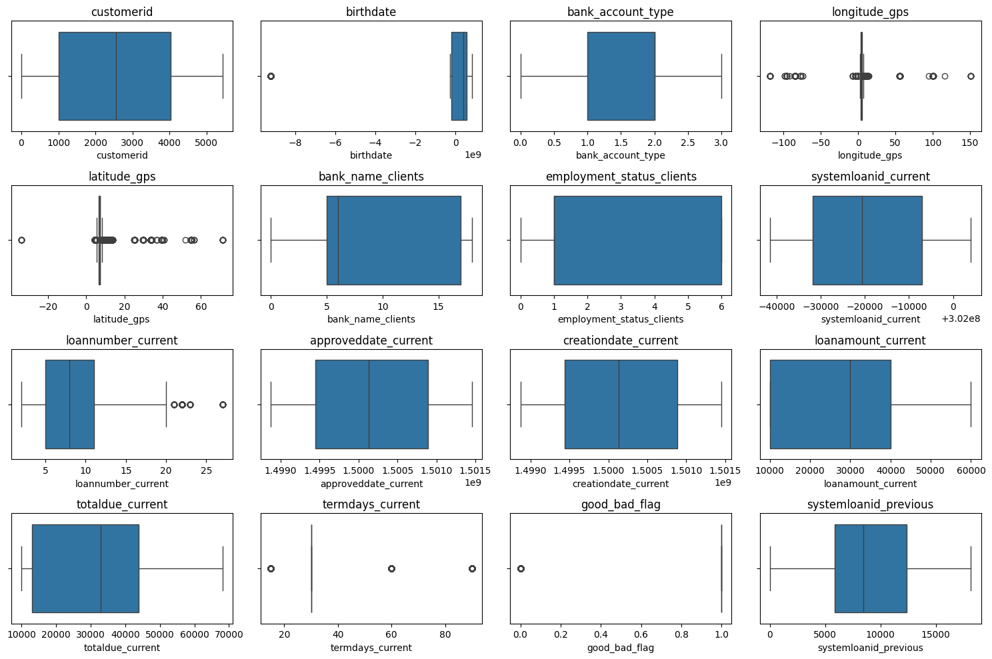
Checking for outliers
Observations & Actions:
Birthdate, Longitude_gps, Latitude_gps, loannumber_current, termdays_current, and good_bad_flag, had outliers.
Their values were averaged with in groups, the original outlier values were later replaced with the averages.

Slide 14
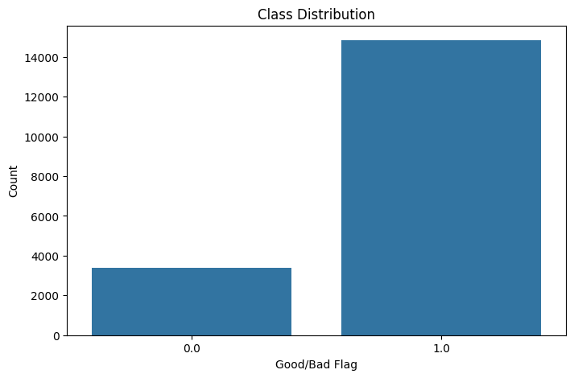
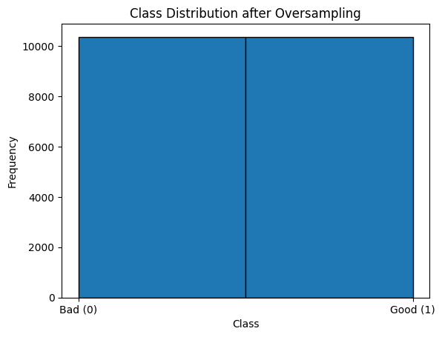
Binary Variable EDA Visualization
Class imbalance
Observations:
Class Imbalance is removed using RandomOverSampler() function class constructor

Slide 15
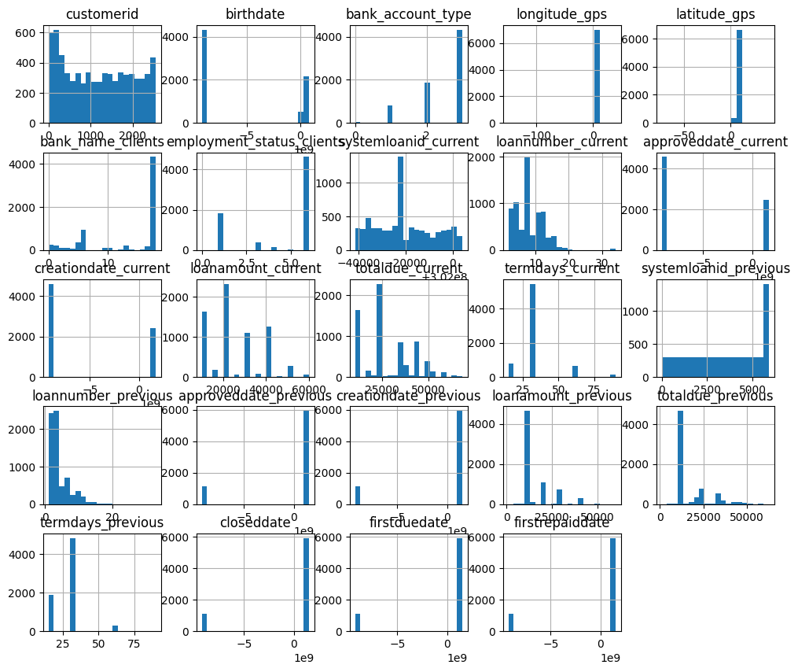
Binary Variable EDA Visualization
EDA Variables Distribution Visualization
Observations:
Feature normality distribution. Most of the features are positively skewed whereas some features are skewed to the left(negative skewness).

Slide 16
Model Selection Training
Implementation and Testing
Support Vector Machine:
Preprocessing and model training details.
2. Random Forest:
Model parameters and feature importance.
3. Logistic Regression:
Standardization and training.
4. Artificial Neural Network:
Normalization and training.
Observations:
The above ML models were used for the training and development of the prediction model

Slide 17
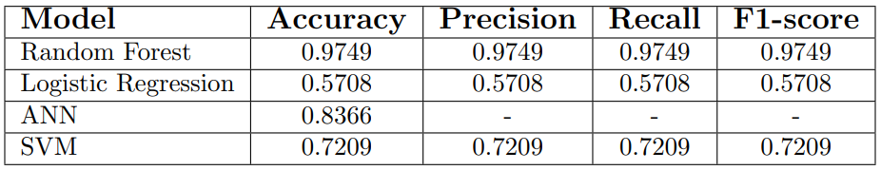
Model Performance Results
Observations:
Best Performer: Random Forest with an almost perfect score in all performance metrics.
Moderate Performance: ANN and SVM, with SVM showing balanced results across all metrics.
Least Effective: Logistic Regression with relatively low performance in all metrics.

Slide 18
Conclusion
Summary:
Successful development and evaluation of models.
Random Forest identified as the best-performing model.
Future Work:
Optimize models for specific regions.
Explore additional data sources for improved accuracy

Slide 19
##THE END ##

